Slide 1
ASPLOS’20
FlexTensor: An Automatic Schedule Exploration an Optimization Framework for Tensor Computation on Heterogeneous System
Size Zheng, Shuo Wang,
Renze Chen, Kaiwen Sheng, Yun Liang*
CHANGWON NATIONAL UNIVERSITY

Slide 2
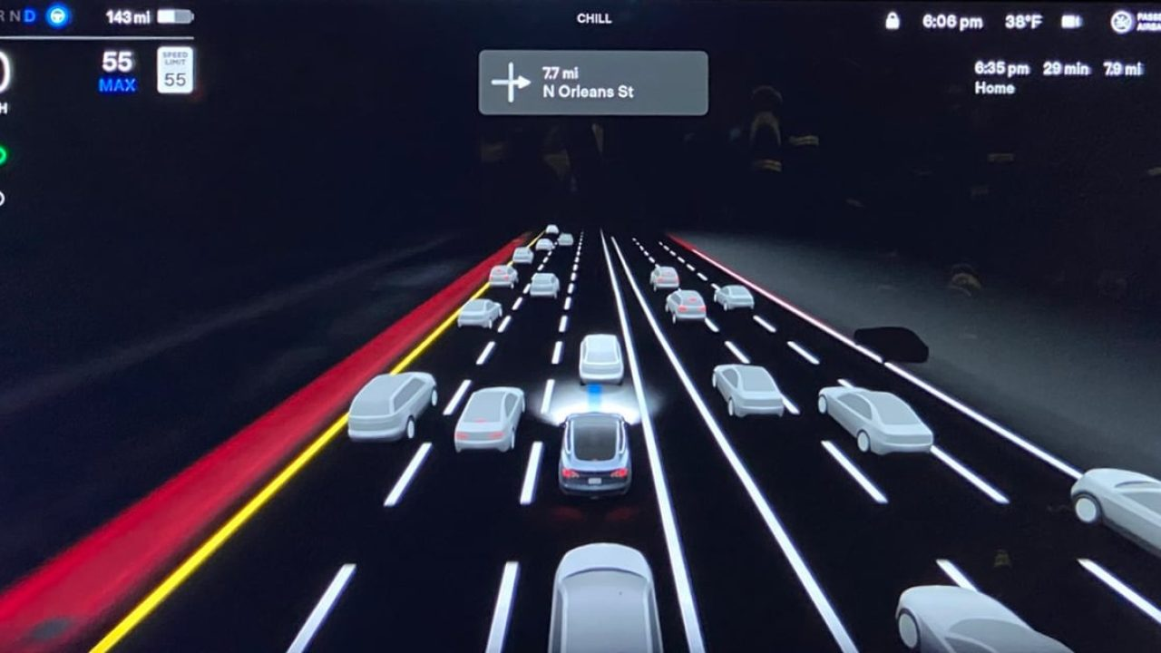
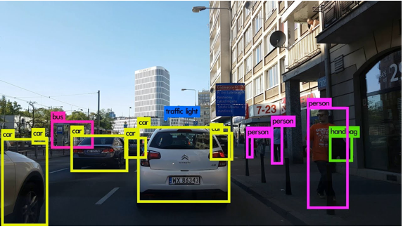


Introduction
Tensor Computations are Everywhere!
Tensor: Multi-dim matrix
Tensor computations:
GEMM
Conv2d
Conv3d
MaxPool
…
AlexNet
YOLO
ResNet
All rely on tensor computations!
LSTM
RCNN

Slide 3
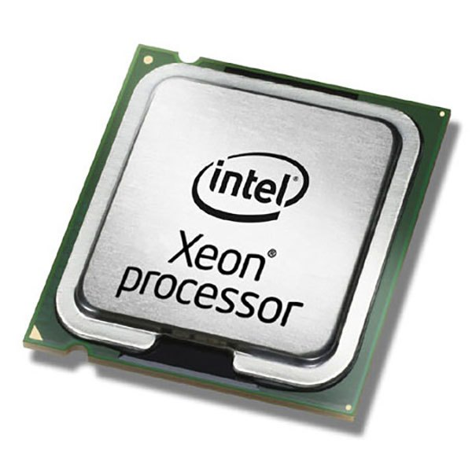
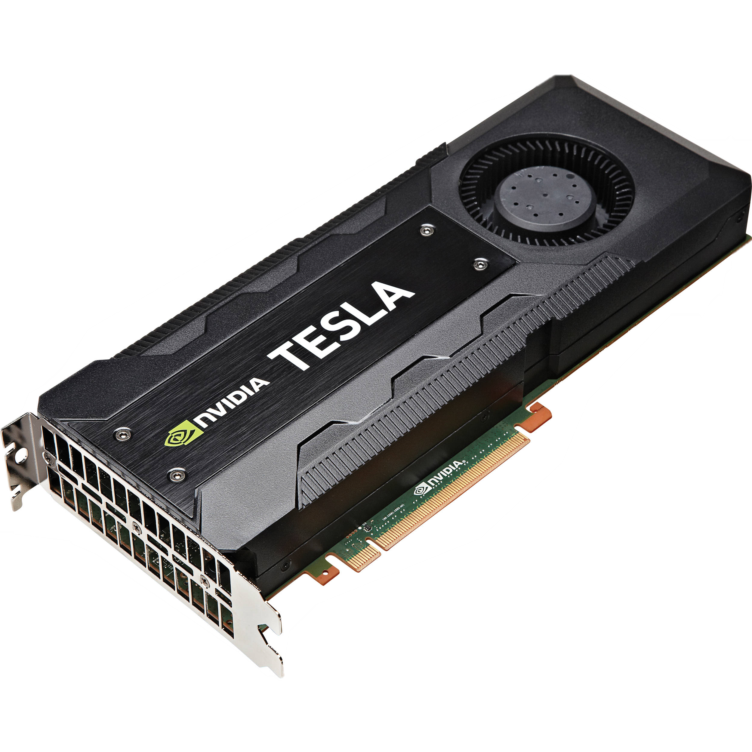
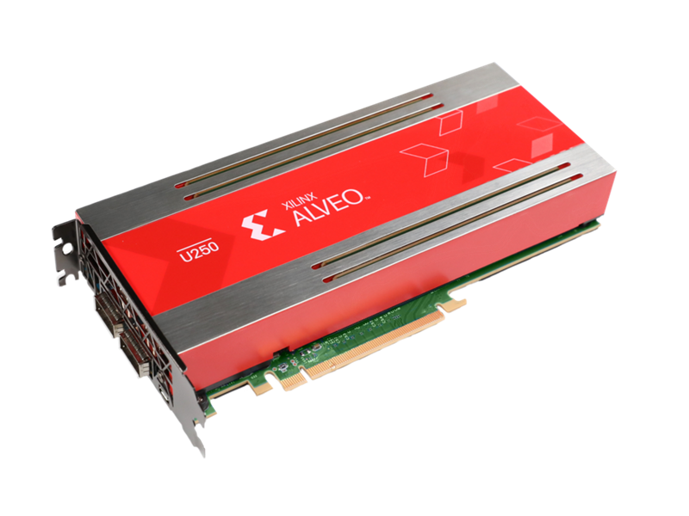


Introduction
Heterogeneous system for accelerating computation
GPU, FPGA, …
Considering all hardware characteristics
by one programmer is difficult!
memory access,
Interconnection,
Bit-width,
…

Slide 4


Introduction
Optimization methods suitable for accelerator have been studied as long time

Slide 5









Introduction
Hand-Optimized Libraries
These libraries have been used by low level implementation
in ML framework

Slide 6
Introduction
Limitations of hand-tuned Libraries
Long Time cost to studying optimization method
Lots of human efforts
Too slow to chase modern application

Slide 7



Introduction
Hand-Optimized Library Flow
라이브러리가 제공하는 연산 method를 알고리즘에 맞게 적재적소에 사용하는 것 또한 어려움
Algorithm
Optimization
Source Code
Manual
Manual
Manual
Long time cost
Hardware-Specific
Expertise required

Slide 8

Related work
To solve this problem, automatic code-generation with scheduling methods are studied
Halide, OSDI’18
TVM, PLDI’13
Algorithm
Optimization
Source Code
Manual
Manual or
Semi-Auto
Auto
Time cost for optimization
Hardware-Specific
Expertise in optimization

Slide 9
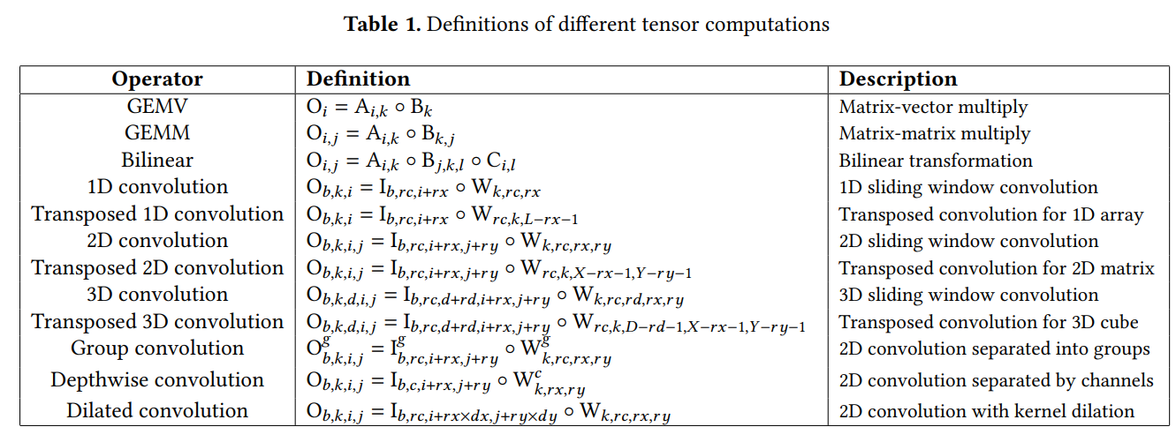
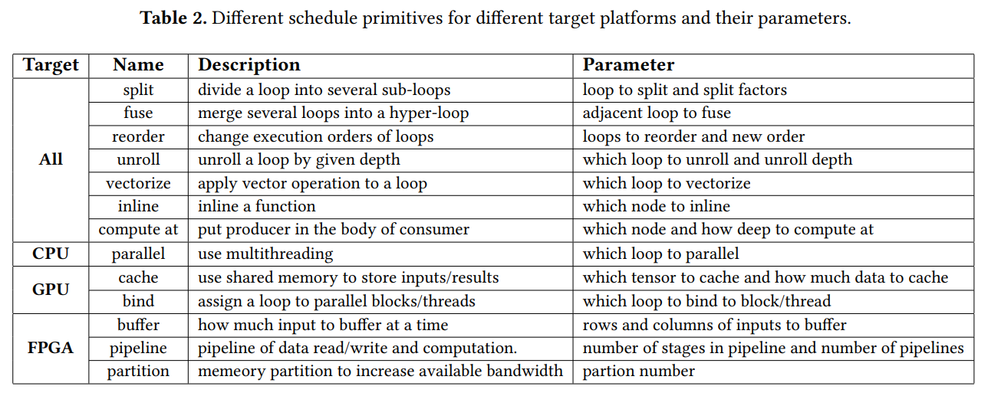
Related work
Code-generation with scheduling
Compute description:
High-level
Algorithm
Mathmatic expressions
Scheduling:
Primitives
Hardware-specific
Parameter for optimization

Slide 10
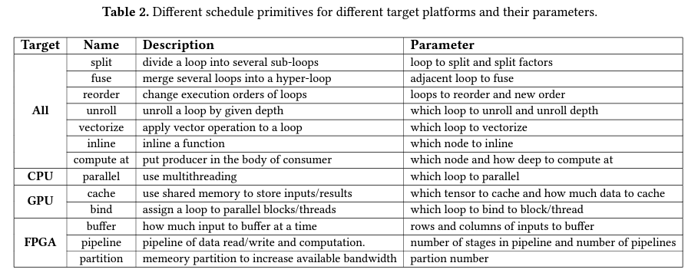
Motivation
Limitations of writing Schedule for optimization
Many primitives to choose
Complex combinations & huge parameter space
Most Schedule primitives related to control loop
반복문 직렬화, 병렬화, 중첩제한, 공유메모리 사용... Etc.
split
reorder
fuse
compute_at
cache_read
tile
compute_inline
…
split
+
reorder
+
fuse
+
…
fuse
+
reorder
+
split
+
…
…

Slide 11
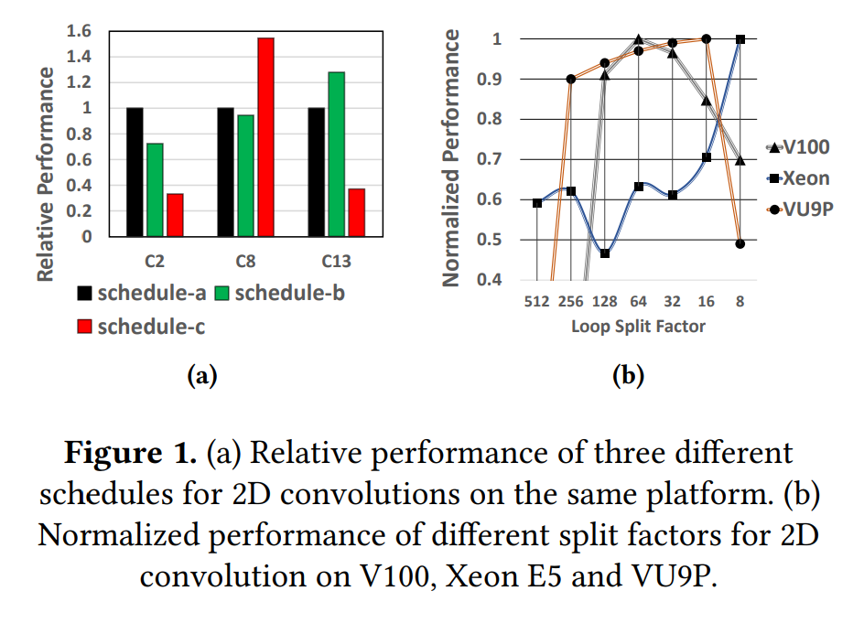
Motivation
Experiment 1
Different scheduling primitive combination
Schedule-a, b, c
Different input Scale
C2, C8, C 13
Experiment 2
Different parameters
Split factor(8 ~ 512)
Different hardware
CPU, GPU, FPGA
Different performance
Difficult to find best case

Slide 12
Motivation
An Ideal Framework:
Auto-optimization
High-performance
Portable
No low-level programming
Short development time

Slide 13
Design
FlexTensor
Algorithm
Optimization
Source Code
Manual
Auto
Auto
Time cost for optimization → Focus on algorithm
Hardware-Specific → Hide H/W detail from user
Expertise in optimization → Only expertise in algorithm

Slide 14
Design
Key Idea:
Replace hand-written schedules with automatic schedule exploration and optimization
Goal | Contribution in FlexTensor
Optimization | Automatic schedule exploration
Portable | Support CPU, GPU, FPGA
Performance | Speedup: 1.83x on GPU, 1.72x on CPU, 1.5x on FPGA
Programming | Only compute description in Python
Development time | 10 min – 1 hour

Slide 15





Design
FlexTensor workflow
: Front-end
Static Analysis
statistical info
Generate
Schedule space
: Back-end
Compute
description
(compute.py)
structure info
Explore
&
Evaluate
Repeat
</>
Generate
Low-level code
Generate
Scheduling
Sequence
Config
Hardware specific
optimized code
Schedule

Slide 16
Design
Key challenges
How to provide schedule for compute?
Generate schedule space
Enumerate possible scheduling primitive combinations
How to guarantee high performance?
Exploration for good schedule(with machine learning technique)

Slide 17


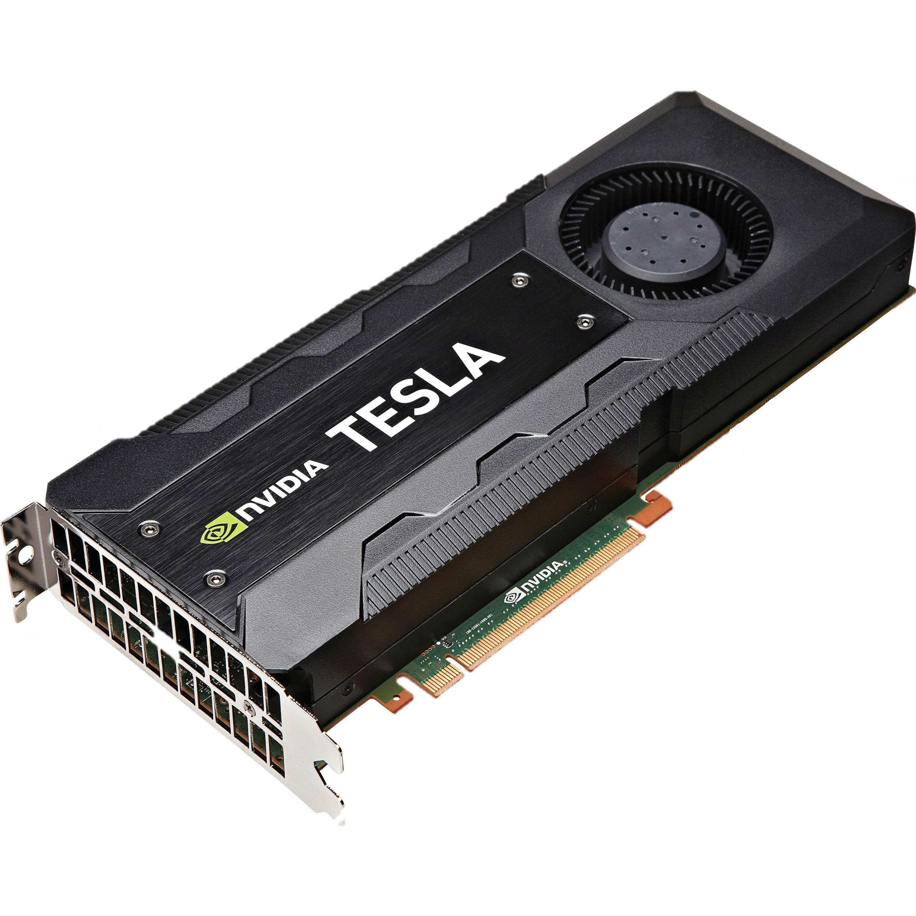
Design
TVM
Optimized Code(H/W friendly, C, C++)
Algorithm code(Python)
Scheduling(python)
for(int outer=0; outer<4; outer=outer+1)
{
C[outer*4+0]=A[outer*4+0]+B[outer*4+0];
C[outer*4+1]=A[outer*4+1]+B[outer*4+1];
C[outer*4+2]=A[outer*4+2]+B[outer*4+2];
C[outer*4+3]=A[outer*4+3]+B[outer*4+3];
} …
def vector_add(A, B):
for i in range(16):
C = A[i] + B[i]
return C
…
C = vector_add(A,B)
S = create_schedule(C)
S.unroll(factor=4)
S.device(cuda)
…
add_module_.py
calculator.py
add_module.cu
unroll()
</>
split()
…
fuse()
Hardware
optimized code
TVM
TVM
Which device?
TVM provide scheduling
Primitive API
device(cuda)
User use scheduling API
for optimizing specific method: optimization expertise required
TVM generate hardware optimization code based on user-level script

Slide 18
Design
FlexTensor evaluate by running each node in the graph on a real device(CPU, GPU, FPGA)
FlexTensor
FlexTensor create graph corresponding to the combination
Optimized Code(H/W friendly, C, C++)
Algorithm code(Python)
Scheduling(python)
for(int outer=0; outer<4; outer=outer+1)
{
C[outer*4+0]=A[outer*4+0]+B[outer*4+0];
C[outer*4+1]=A[outer*4+1]+B[outer*4+1];
C[outer*4+2]=A[outer*4+2]+B[outer*4+2];
C[outer*4+3]=A[outer*4+3]+B[outer*4+3];
} …
def vector_add(A, B):
for i in range(16):
C = A[i] + B[i]
return C
…
C = vector_add(A,B)
S = create_schedule(C)
S.unroll(factor=4)
…
add_module_.py
calculator.py
add_module.cu
Evaluate Schedule
(CPU, GPU)
</>
Generate schedule
unroll(1)
unroll(2)
unroll(3)
unroll(4)
split(1)+unroll(0)+…
…
split(n)+unroll(n)+…
→ 12
→ 13
→ 11
→ 10
→ 4 + 3 …
→ …
→ n + n …
Hardware
optimized code
TVM
FlexTensor generate optimal scheduling code (actually, generate device code directly)
[12,13,11,{4+3+…},{n+n+…},…]
FlexTensor also use scheduling primitives at TVM to generate scheduling combination
unroll(4)
is best!
DQN find shortest path at the graph
which means optimal combination
DQN

Slide 19
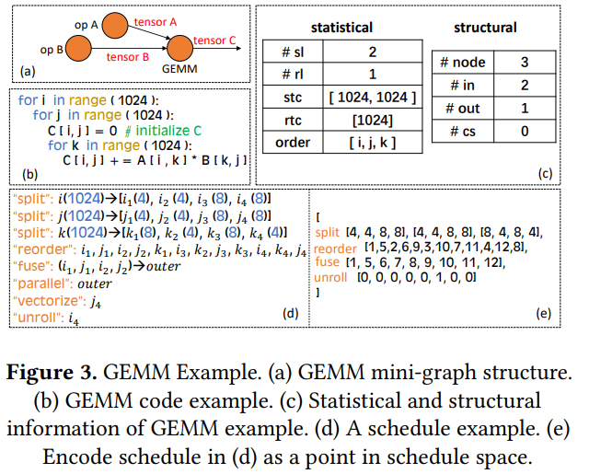
Design
Schedule Space Generation
Compute description
Static analysis of GEMM(tensor multiplication)
C = compute( ( 16, ), lambda i: A[i] + B[i] )
Statistical
information
Structural
information
Loop trip counts
Number of loops
Loop order
Computation graph
structure
Producer consumer
relationship

Slide 20
Design
Schedule Space Generation(cont.)
Determine the ideal schedule → Encode the schedule
Statistical
information
Structural
information
Limit the depth of primitive combination
Prune the parameter space
Pre-determine certain decision for different
hardware
Enumerate primitive combinations
And parameter settings
split
reorder
fuse
compute_at
cache_read
tile
compute_inline
…

Slide 21
Design
Exploring large schedule space efficiently
Rearrange schedule based on structural similarities
Pruning(가지치기)
Limit the depth of primitives combination(set threshold)
Parameter pruning(set split factor threshold)
Pre-determine certain decision for different hardware
Fix the parallelism by hardware capacity( CPU core, GPU threads in block)

Slide 22
Design
After pruning, rearranging the schedule space
Transform to higher dimension
According to similarity
x

Slide 23
Design
After pruning, rearranging the schedule space
start
optimal
7
start
Rearranging has potential to
shorten the optimal path!
3
x
optimal

Slide 24
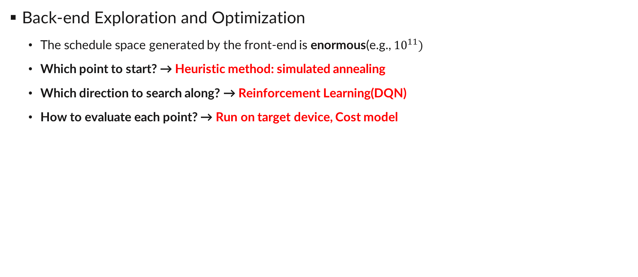
Design
Back-end Exploration and Optimization
The schedule space generated by the front-end is enormous(e.g., ${10}^{11})$
Which point to start? → Heuristic method: simulated annealing
Which direction to search along? → Reinforcement Learning(DQN)
How to evaluate each point? → Run on target device, Cost model
start
x
Both selection, searching algorithm are
using performance evaluation value
optimal

Slide 25
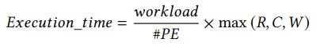
Design
Performance evaluation
Measuring real target device
Accurate, Portable, Overhead
Estimate the performance by using analytical model
Very fast, Dependency
This paper choose measurement approach on CPU and GPU
FPGA using estimation approach (netlist issue)
Cost model:

Slide 26
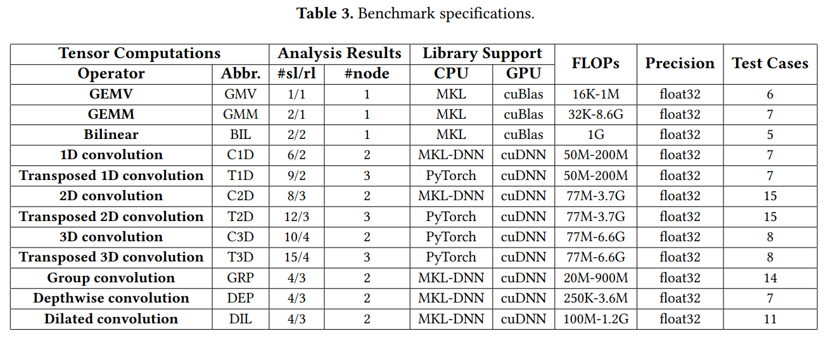
Experiment
Expreiments set up
FlexTensor implemented in Python
Use TVM tool for code generation(Device executable code compiler)
Benchmarks
12 widely used operator(Conv, GEMM, Etc.)

Slide 27
Experiment
Baseline for comparison
CPU: MKL-DNN
Operations not supported by MKL-DNN and cuDNN were compared using Pytorch-native implementation
GPU: cuDNN
FPGA: hand-optimized
Hardware
CPU: Intel Xeon E5-2699
GPU: Nvidia V100, P100, TitanX
FPGA: Xilinx VU9P FPGA

Slide 28
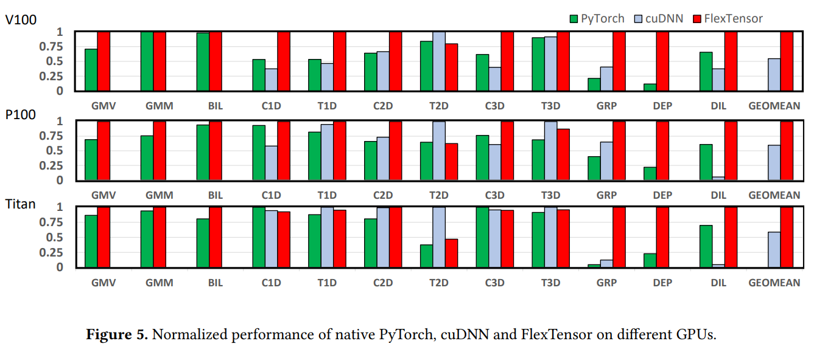
Experiment
Normalized performance
FlexTensor outperforms cuDNN 1.54x to 21.35 speedup on GPUs
For DEP, FlexTensor to PyTorch ranges from 4.39x to 8.53x.

Slide 29
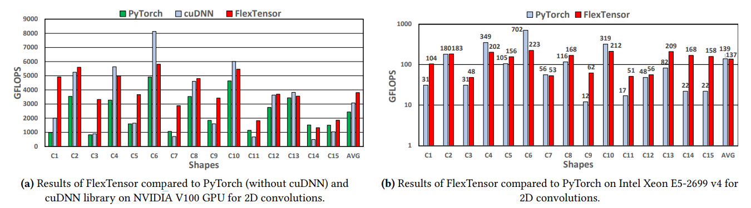
Experiment
Absolute performance per input shape
In most case, FlexTensor is better than hand-optimization
FlexTensor dynamically adapt to different input shapes and search for proper schedules
C6, C10, cuDNN is better than TensorFlex, because cuDNN use special algorithms(Winograd)

Slide 30
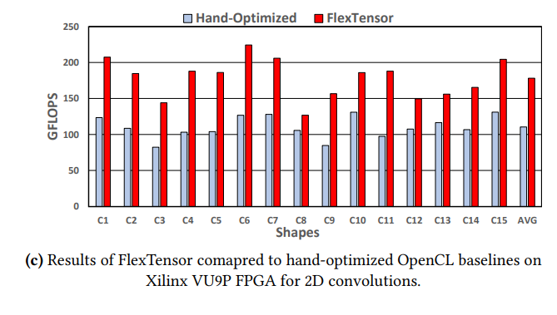
Experiment
Absolute performance per input shape
In most case, FlexTensor is better than MKL-DNN
The geometric speedup to the MKL is 1.72x
FlexTensor can achieve high-performance thanks to efficient tiling and vectorization

Slide 31
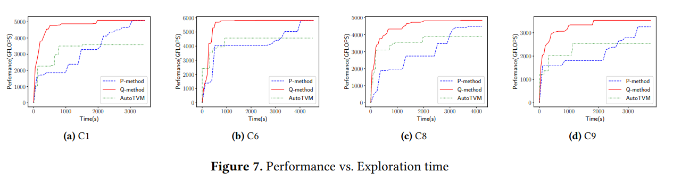
Experiment
Performance vs. Exploration time
Q-method: FlexTensor with Q-learning(optimization mechanism for determine direction)
P-method: FlexTensor without Q-learning, tries all possible direction at each trial
AutoTVM: automatic tunning method in TVM
Q-method only use 27.6% the time of AutoTVM

Slide 32
Conclusion
FlexTensor
Fully automatic scheduling
Support heterogeneous system
Heuristic and reinforcement for optimization
High performance
https://github.com/pku-liang/FlexTensor
Algorithm
Optimization
Source Code
Manual
Auto
Auto

